Slide 1
PHP: HyperText Preprocessor

Slide 2
What is PHP?
PHP is a widely-used, open source scripting language
PHP scripts are executed on the server
PHP
server scripting language
powerful tool for making dynamic and interactive Web pages
PHP
widely-used
Free
efficient alternative to competitors such as Microsoft's ASP.

Slide 3
What PHP can do?
PHP can generate dynamic page content
PHP can create, open, read, write, delete, and close files on the server
PHP can collect form data
PHP can send and receive cookies
PHP can add, delete, modify data in your database
PHP can be used to control user-access
PHP can encrypt data

Slide 4
Why PHP?
PHP runs on various platforms (Windows, Linux, Unix, Mac OS X, etc.)
PHP is compatible with almost all servers used today (Apache, IIS, etc.)
PHP supports a wide range of databases
PHP is free. Download it from the official PHP resource: www.php.net
PHP is easy to learn and runs efficiently on the server side

Slide 5
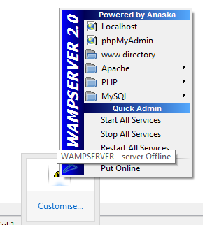
How to run PHP?
Install wamp server
Type the following code in note pad and save as ex1.php
Save it in MyPHP folder
Place MyPHP folder in WWW folder
<!DOCTYPE html> <html> <body> <h1>My first PHP page</h1> <?php echo "Hello World!“;
?> </body> </html>

Slide 6
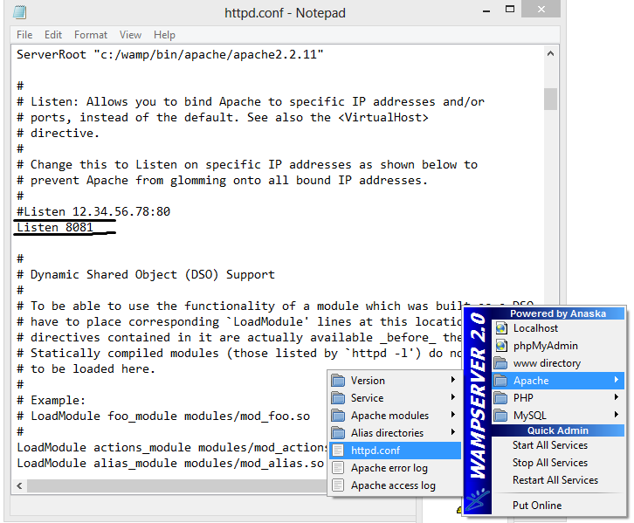
Change the configuration file (If there is error in starting the wamp server)

Slide 7
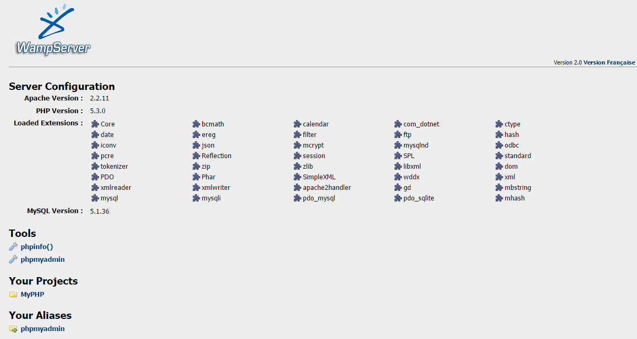
Start all services and navigate to http://localhost:8081

Slide 8
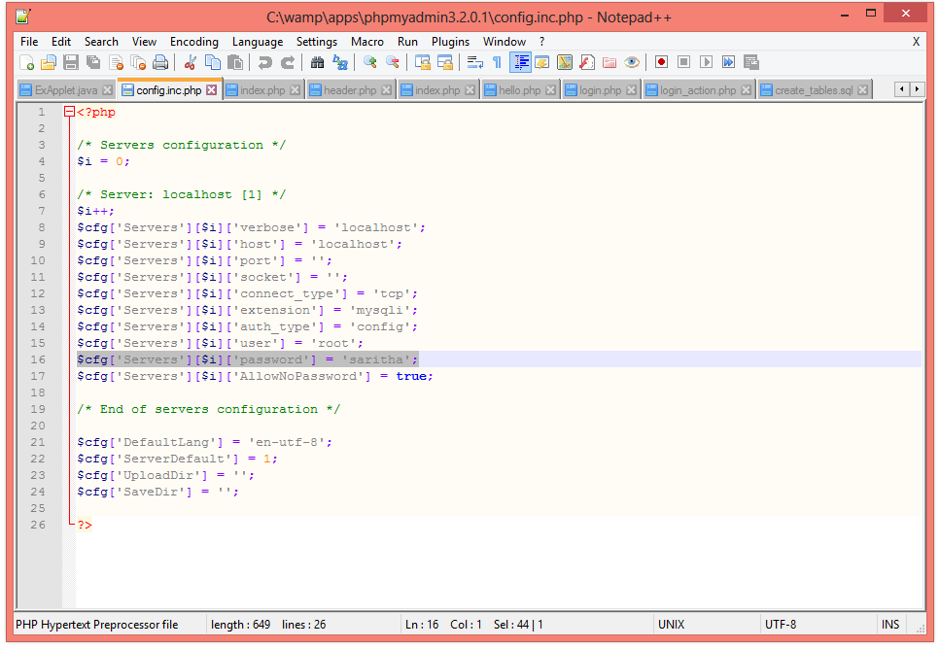
Set Password in config file
In order to use database form PHP, set the password of the mysql server in the config-inc.php in C:\wamp\phpmyadmin3.2.0.1

Slide 9
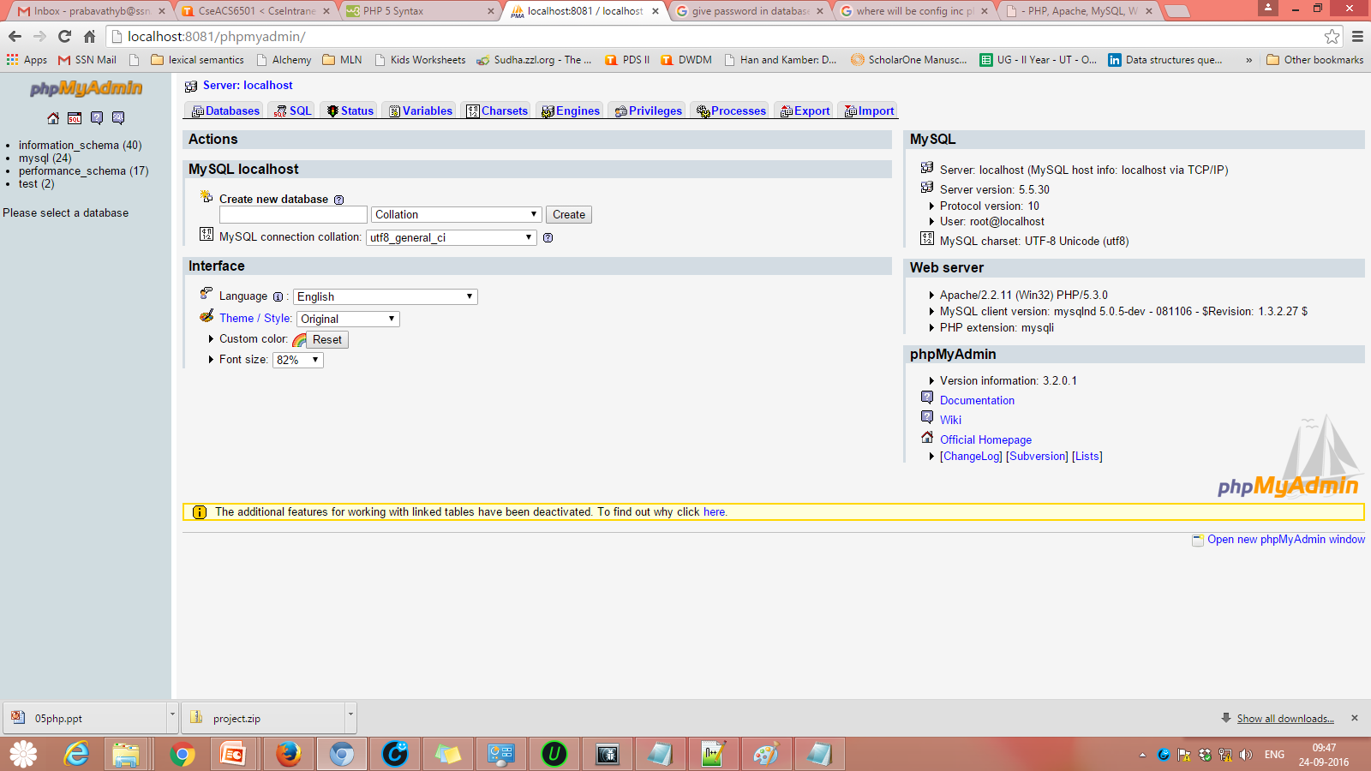
After changing the password, Click the phpmyadmin link

Slide 10
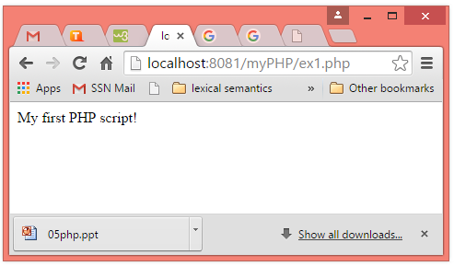
Execution of First PHP script

Slide 11
Comments in PHP
<html> <body> <?php // This is a single-line comment # This is also a single-line comment /* This is a multiple-lines comment block that spans over multiple lines */ // You can also use comments to leave out parts of a code line $x = 5 /* + 15 */ + 5; echo $x; ?> </body> </html>

Slide 12
PHP Variables
A variable starts with the $ sign, followed by the name of the variable
A variable name must start with a letter or the underscore character
A variable name cannot start with a number
A variable name can only contain alpha-numeric characters and underscores (A-z, 0-9, and _ )
Variable names are case-sensitive ($age and $AGE are two different variables)

Slide 13

PHP Variables
Example
<html> <body> <?php $txt = "Hello world!"; $x = 5; $y = 10.5; echo $txt; echo "<br>"; echo $x; echo "<br>"; echo $y; ?> </body> </html>
Output
PHP has no command for declaring a variable.
It is created the moment you first assign a value to it.

Slide 14
PHP echo statement
The PHP echo statement is often used to output data to the screen.
The following example will show how to output text and a variable:
<?php $txt = "W3Schools.com"; → will print I love W3Schools.com echo "I love $txt!"; ?>
<?php $txt = "W3Schools.com"; → will print I love W3Schools.com echo "I love " . $txt . "!"; ?>
<?php $x = 5; $y = 4; echo $x + $y; → will print 9 ?>

Slide 15
PHP Strings
<?php echo strlen("Hello world!"); // outputs 12 ?>
<?php echo str_word_count("Hello world!"); // outputs 2 ?>
<?php echo strrev("Hello world!"); // outputs !dlrow olleH ?>
<?php echo strpos("Hello world!", "world"); // outputs 6 ?>

Slide 16
PHP if statements
Example for if statement
<?php $t = date("H"); if ($t < "20") { echo "Have a good day!"; } ?>
Example for if-else statement
<?php $t = date("H"); if ($t < "20") { echo "Have a good day!"; } else { echo "Have a good night!"; } ?>
Example for if-else-elseif statement
<?php $t = date("H"); if ($t < "10") { echo "Have a good morning!"; } elseif ($t < "20") { echo "Have a good day!"; } else { echo "Have a good night!"; } ?>

Slide 17
PHP Switch statement
<?php $favcolor = "red"; switch ($favcolor)
{ case "red": echo "Your favorite color is red!"; break; case "blue": echo "Your favorite color is blue!"; break; case "green": echo "Your favorite color is green!"; break; default: echo "Your favorite color is neither red, blue, nor green!"; } ?>

Slide 18
PHP while loop
<?php $x = 1; while($x <= 5) { echo "The number is: $x <br>"; $x++; }
?>
<?php $x = 6; do { echo "The number is: $x <br>"; $x++; } while ($x <= 5);
?>
<?php for ($x = 0; $x <= 10; $x++) { echo "The number is: $x <br>"; }
?>

Slide 19
PHP Form Handling
<html> <body>
<form action="welcome.php"
method="post"> Name: <input type="text" name="name"><br> E-mail: <input type="text"
name="email"><br> <input type="submit"> </form> </body> </html>
<html> <body> Welcome <?php echo $_POST["name"]; ?><br> Your email address is: <?php echo $_POST["email"]; ?> </body> </html>

